Slide 1

A Project Review Presentation on STOCK MARKET PRICE PREDICTION USING MACHINE AND DEEP LEARNING TECHNIQUES
Presented by Batch CS 25-11
V Siva Samhitha 21121A3759
D Sai Tejaswini 21121A3711
P Jnyana Prasoona 21121A3740
S Rakesh 21121A3747
Computer Science and Systems Engineering
Under the guidance of
Mr. P. Yogendra Prasad,
Assistant Professor,
Dept. of CSSE
HOD
Dr. P. K. Reddy Madhavi,
Professor & Head,
Dept. of CSSE

Slide 2
Contents
Abstract
Introduction
Statement of the problem
Motivation
Objectives
Literature survey
Limitations of Existing Model
Physical Model
Proposed System
Software and Hardware Requirements
Simulation Model
Performance Evaluation
Analysis of Experimental data
Implementation and Results
Conclusion
Future Work
References

Slide 3
Abstract
Our project, “Stock Market Price Prediction Using Machine Learning and Deep Learning”, focuses on forecasting the next 5 candles for any NSE or BSE stock. We began by conducting a comprehensive analysis of various algorithms to identify the most accurate model for predicting stock prices. After comparing models such as LGBM, CNN, LSTM, and XG Boost, we discovered that a hybrid approach combining CNN and LSTM outperformed others, delivering results closest to real stock prices.
To enhance short-term forecasting, we integrated ARIMA for analyzing time-series data. Real-time stock data is fetched using

Slide 4
Abstract
APIs, ensuring predictions are up-to-date and relevant. The entire
system is deployed on a user-friendly website, enabling users to
access predictions effortlessly.
The results are expected to provide insights into the applicability of machine learning and deep learning techniques in financial forecasting, potentially leading to more accurate and reliable stock price predictions.
This Project outcome is a reliable tool for investors to make informed decisions based on accurate and timely stock price predictions.

Slide 5
Introduction
Stock Market Overview:
Backbone of the economy; facilitates investments and trading.
Highly dynamic, influenced by external factors like global event.
Stock Market:
Acts as a backbone of economic growth and investment opportunities.
Requires precise predictions due to its dynamic nature.
Our Solution:
Leverages machine learning and deep learning techniques to analyze historical data and predict future trends.
Ensures accessibility through an interactive website.

Slide 6
Statement of Problem
Challenges:
- Stock price prediction is highly influenced by market volatility and external factors.
Impact:
- Retail investors and small-scale traders face difficulty in making informed decisions.
- Poor investment decisions can lead to reduced market participation, affecting overall market liquidity and growth.
Need for a Solution:
- Integrating machine learning and real-time data can provide accurate,
predictions, empowering investors with better decision-making tools.

Slide 7
Motivation
Why This Project?
Empower investors with an accurate prediction tool.
Bridge the gap between complex analytical models and user-friendly solutions.
Leverage real-time data for better decision-making.
Provide a reliable platform for retail investors and small-scale traders.

Slide 8
Objectives
Predict the next 5 candles for any NSE/BSE stock with high accuracy using machine learning and deep learning models.
Compare the performance of multiple models (LSTM, CNN, LGBM, XG Boost) to identify the best approach.
Integrate real-time stock data through APIs to ensure up-to-date predictions.
Develop a user-friendly website to display stock predictions and visualizations.
Ensure predictions are visualized on a simple, intuitive website interface.

Slide 9
Literature Survey
Existing Methods:
- Simple Moving Average (SMA) and Exponential Moving Average (EMA):
Effective for trend following but lack adaptability.
- Linear Regression: Good for trend analysis but not suitable for complex,
non-linear patterns.
- LGBM, LSTM and RNN: Strong at handling sequential data but
resource-intensive.
- XG Boost: Efficient but lacks the accuracy of deep learning models for
time-series data.
Findings:
- Hybrid CNN-LSTM approach achieves higher accuracy by combining
spatial and temporal analysis.
- Limited real-time integration in existing systems.

Slide 10
Limitations of Existing Methods
1. Static Data Dependency :
Techniques like Simple Moving Average (SMA) and Exponential Moving
Average (EMA) are widely used in stock market analysis. However, these
methods heavily depend on historical data and fail to adapt to real-time
market fluctuations. This static nature limits their ability to predict dynamic market trends effectively, particularly in fast-changing conditions.
2. Lack of Usability :
Many existing stock market prediction tools are designed with advanced
functionalities, making them overly complex for non-technical users. Additionally, they lack intuitive user interfaces, making it challenging for

Slide 11
Limitations of Existing Methods
technical expertise.
3. Challenges with Market Volatility :
Stock markets are inherently volatile, with sudden and unexpected price movements caused by macroeconomic events, geopolitical developments, or investor sentiment. Existing models often struggle to adapt to such high-volatility scenarios, resulting in inaccurate or delayed predictions during critical market conditions.

Slide 12
Network Model
CNN-LSTM Hybrid Model:
- CNN: Extracts spatial patterns in stock data.
- LSTM: Identifies temporal dependencies for accurate forecasting.
ARIMA Model:
- Used for short-term time-series forecasting.
- Captures trends, seasonality, and noise in stock price data.
Workflow:
Collect and preprocess historical stock data.
Train ARIMA and hybrid CNN-LSTM models.
Predict next 5 candles.
Visualize results on the website.

Slide 13
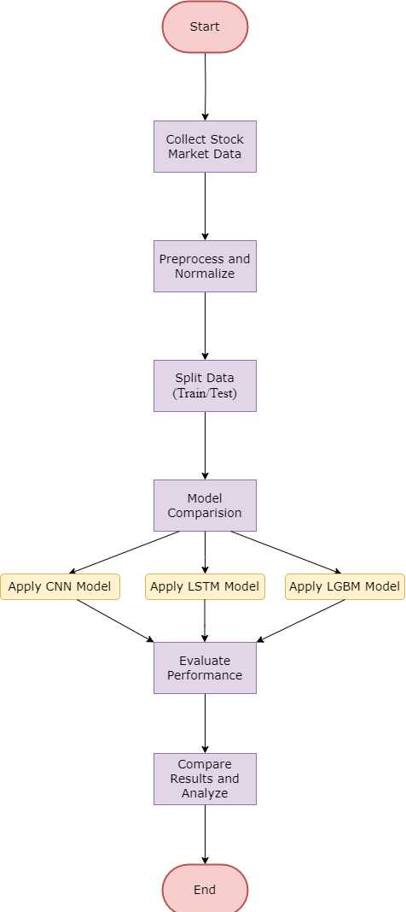

Slide 14
Proposed System
System Components:
- Input: Historical and live stock data fetched via APIs.
- Processing: Hybrid CNN-LSTM for long-term trends; ARIMA
for short-term forecasts.
- Output: Predicted prices visualized as candlestick charts.
- User Interface: Website for interaction and result visualization.
Algorithm Workflow:
Fetch real-time data using APIs.
Preprocess data (handle missing values, outliers).
Train ARIMA and CNN-LSTM models.
Combine results for accurate predictions.
Display output on the website.

Slide 15
Software and Hardware Requirements
Software:
- Python 3.12 (Libraries: Pandas, NumPy, Streamlit, Statsmodels,
TensorFlow, Keras, yfinance, Matplotlib, Scikit Learn, Django).
- APIs: Yahoo Finance.
- Web Development: HTML, CSS, JavaScript, Bootstrap.
Hardware:
- Minimum: Intel i5, 8 GB RAM, 256 GB SSD.
- Recommended: Intel i7, 16 GB RAM, 512 GB SSD.
GPU for training deep learning models (e.g., NVIDIA GTX
1650 or higher).

Slide 16
Simulation Model
start
Collect stock market data
Data Preprocessing
Generate Technical Indicators
(RSI, MACD, Moving Average)
Train Models
Predict Future Stock
Prices Using CNN-LSTM
Visualize Predictions
(Actual vs. Predicted)
End

Slide 17
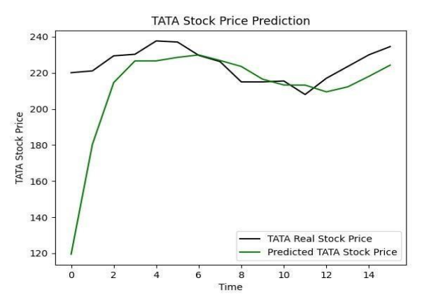
Performance Evaluation
Actual vs. Predicted Prices Graph → Shows how close CNN-LSTM predictions are to real stock prices

Slide 18
Performance Evaluation
Metric | CNN-LSTM Model (Deep Learning) | Traditional ML Models (SVM, RF, etc.)
RMSE | Lower (Better) | Higher (Less Accurate)
MAE | Lower (More Precise) | Higher (Less Reliable)
R² Score | Closer to 1 (Better Fit) | Less Predictive Power
CNN-LSTM outperforms traditional ML models by effectively capturing time-series dependencies.

Slide 19
Analysis of experimental data
CNN-LSTM outperforms all other models, achieving the best
trade-off between accuracy and generalization.
The CNN-LSTM model closely follows actual price trends, indicating strong predictive capabilities.
Short-term stock predictions (5-day forecast) are highly accurate, making the model useful for real-time market analysis.
By combining historical prices with technical indicators, the
CNN-LSTM model learns better patterns and provides more
reliable 5-day stock predictions.
Further improvements can be achieved by integrating news
sentiment analysis or reinforcement learning for adaptive
predictions

Slide 20

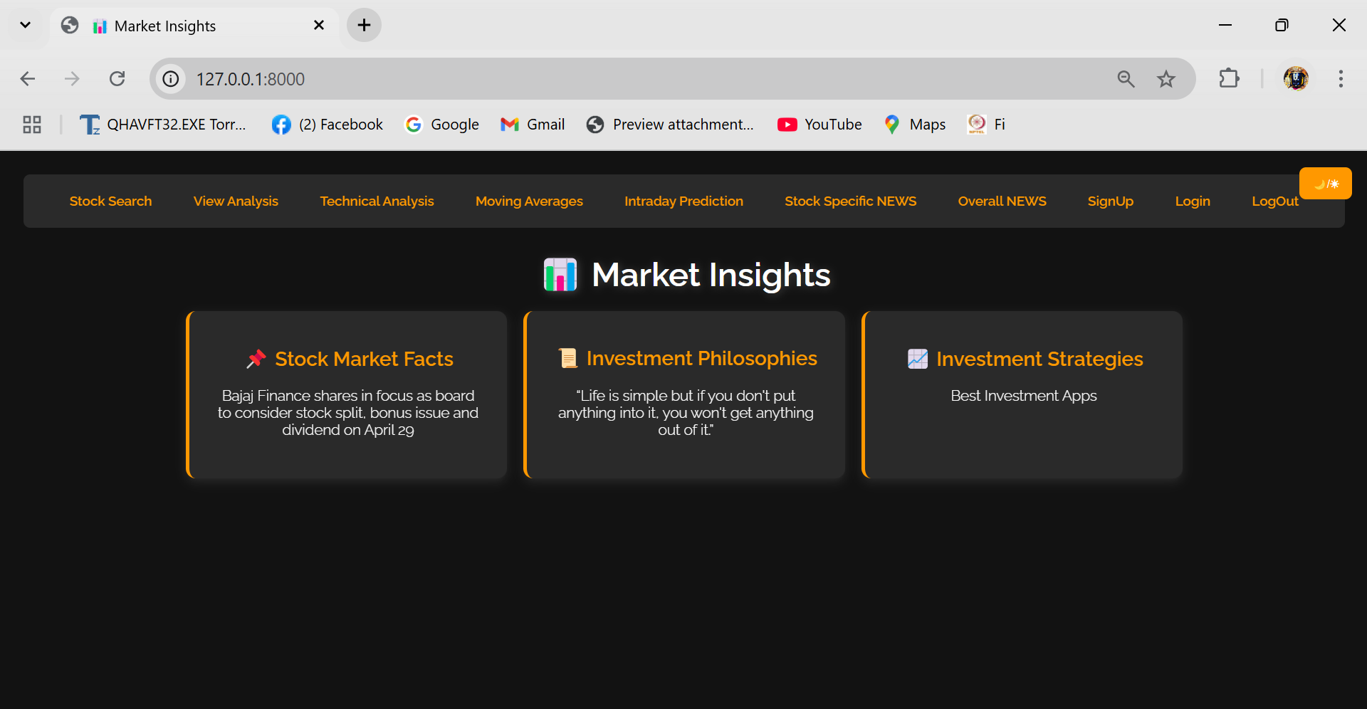
Implementation and Results

Slide 21
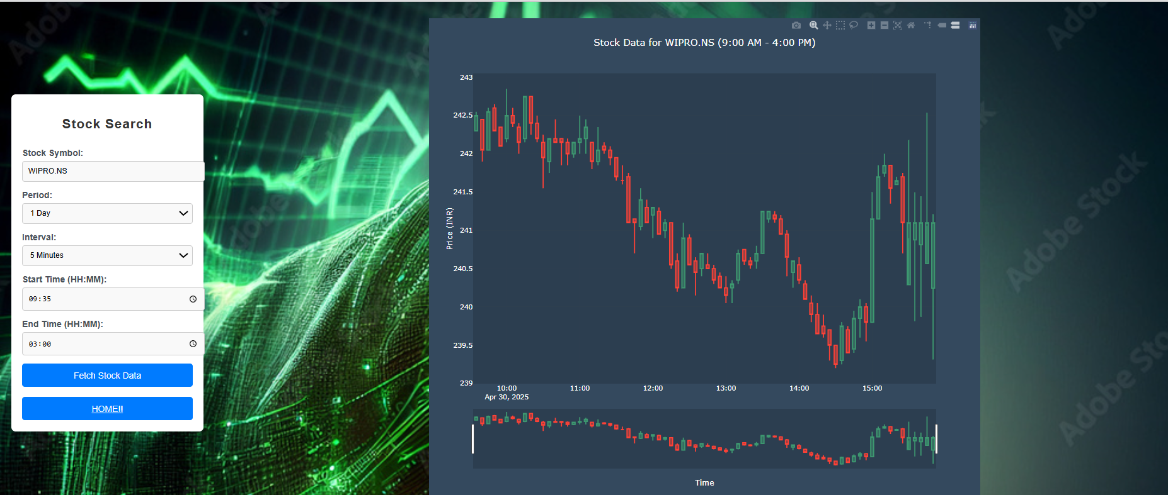
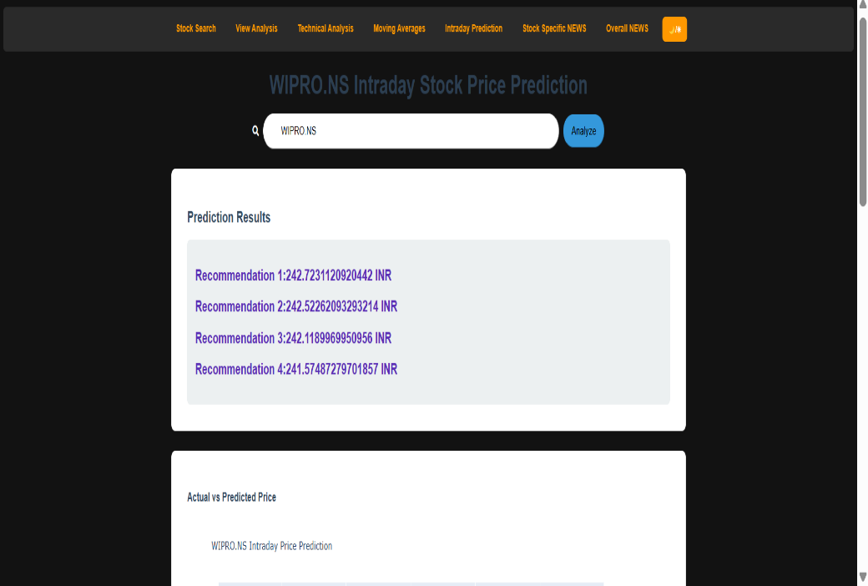
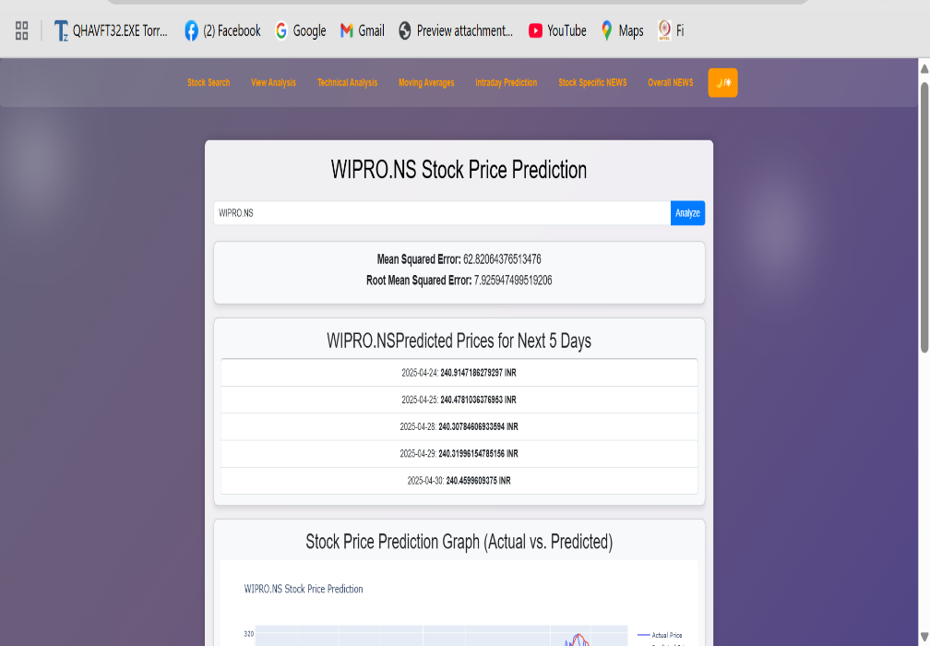

Slide 22
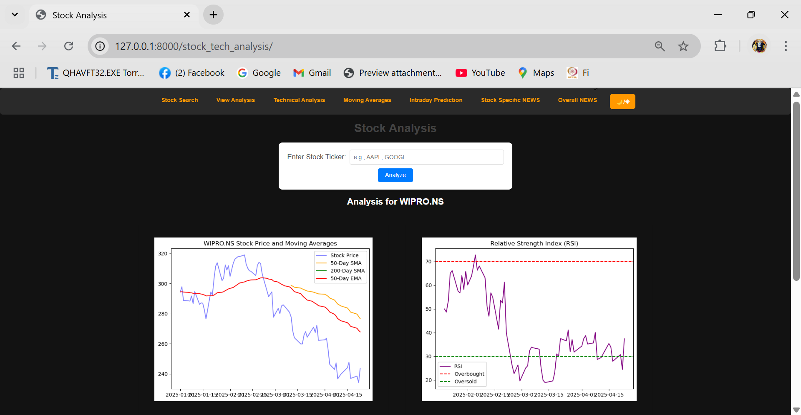
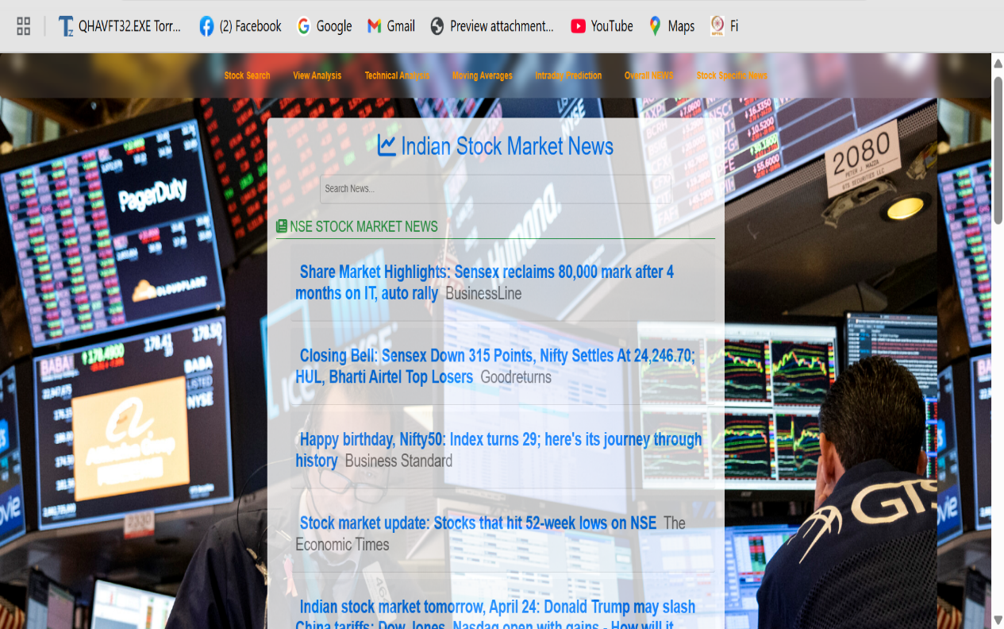
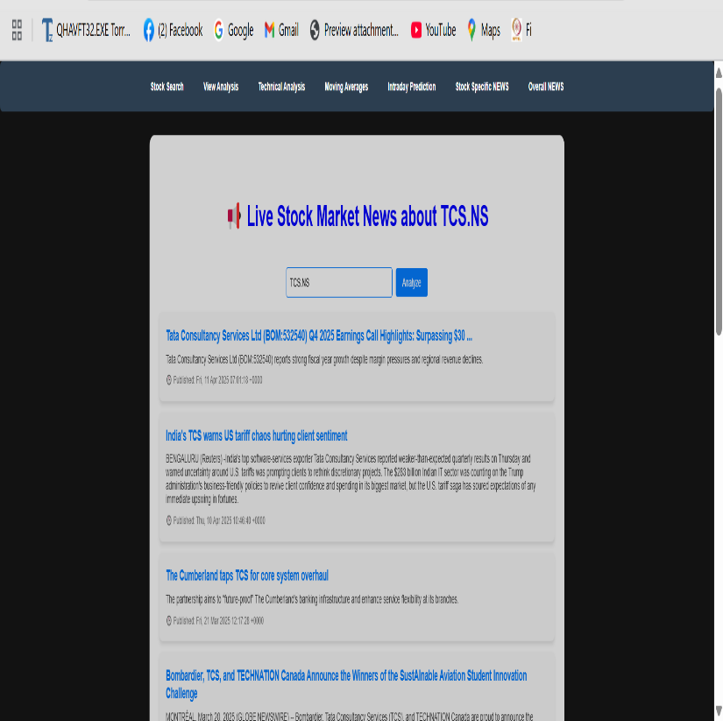

Slide 23
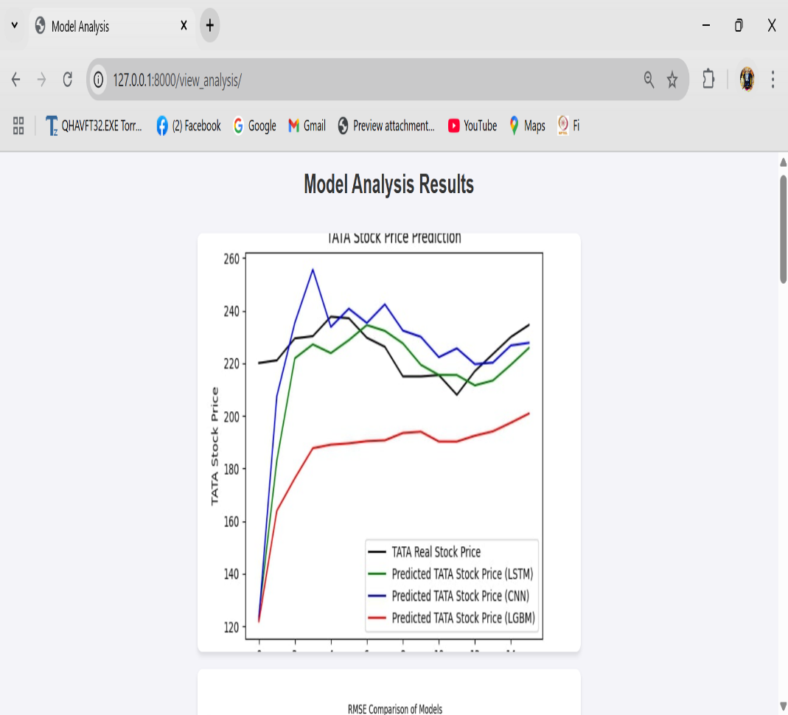


Slide 24
Conclusion
In this project, we focused on predicting stock market prices using both Machine Learning and Deep Learning techniques. We implemented and evaluated four models - CNN, LSTM, XG Boost, and LGBM on historical stock data to identify the most effective prediction method. After thorough comparison, we found that CNN and LSTM individually performed better, so we combined them into a hybrid CNN-LSTM model. This hybrid approach captured both spatial patterns and long-term dependencies in stock data, leading to more accurate and reliable predictions. Additionally, we developed a web application that presents real-time stock information, news, and technical indicators like RSI, MACD, Moving Averages, and Bollinger Bands, making the system user-friendly and practical for real-world use. Overall, our project demonstrates how intelligent algorithms and real-time analytics can support smarter financial decisions in a volatile market environment.

Slide 25
Future work
Real-Time News Sentiment Analysis
We plan to integrate natural language processing (NLP) techniques to perform sentiment analysis on real-time financial news and social media. This would allow the model to account for public sentiment, improving prediction accuracy during volatile events.
Portfolio Recommendation System
We also aim to develop an intelligent system that not only predicts stock prices but also recommends a portfolio of stocks based on user preferences, risk profile, and market trends using reinforcement learning or multi-objective optimization.

Slide 26
References
Mohamed El Mahjouby, Khalid El Fahssi, Mohamed Taj Bennani, Mohamed Lamrini, Mohamed El Far, “Utilizing Deep Learning and Machine Learning Methods to Forecast Market Performance”, 2024 Sixth International Conference on Intelligent Computing in Data Sciences (ICDS), pp.1-4, 2024.
M Asit Kumar Das, Debahuti Mishra, Kaberi Das, Kailash Chandra Mishra, “A Feature Ensemble Framework for Stock Market Forecasting Using Technical Analysis and Aquila Optimizer”, IEEE Access, vol.12, pp.187899-187918, 2024.
Mohammed Ali Shaik, Nallani Lakshmi Sri, “A Comparison of Stock Price Prediction Using Machine Learning Techniques”, 2024 5th International Conference on Electronics and Sustainable Communication Systems (ICESC), pp.1-5, 2024.

Slide 27
References
Aditi A. Salokhe, Yash Kashid, Yash Chougale, Yashodhan Darekar, “Stock Price Prediction Using Machine Learning”, International Journal of Advanced Research in Computer and Communication Engineering, vol.13, no.4, pp.164-170,2024.
G. Rekha, D. B. Sravanthi, S. Ramasubbareddy, and K. Govinda, ‘‘Prediction of stock market using neural network strategies’’ J. Comput. Theor. Nanoscience, vol. 16, no. 5, pp. 2333–2336, May 2019.
Shayan Halder, “FinBERT-LSTM: Deep Learning based stock price prediction using News Sentiment Analysis”, arXiv preprint, vol.arXiv:2211.07392, 2022.
Deepak Kumar, Pradeepta Kumar Sarangi, Rajit Verma, “A systematic review of stock market prediction using machine learning and statistical techniques”, ScienceDirect, Vol:49, Part 8, Pages 3187-3191 ,2022.

Slide 28
Thank You

